Slide 1

Game Co Objectives
Project 1:
Game Co, a newly established video game company, aims to leverage data analysis to comprehend market trends, formulate strategic plans, and drive growth in the most viable markets."
Objectives
Analyze global sales trends over the past years
Identify top-performing platforms and publishers to understand market competition
Provide actionable insights to guide Game Co's game development and market strategy
Methods
Grouping, sorting and filtering data in Excel
Data cleaning
Descriptive analysis
Data visualization

Slide 2
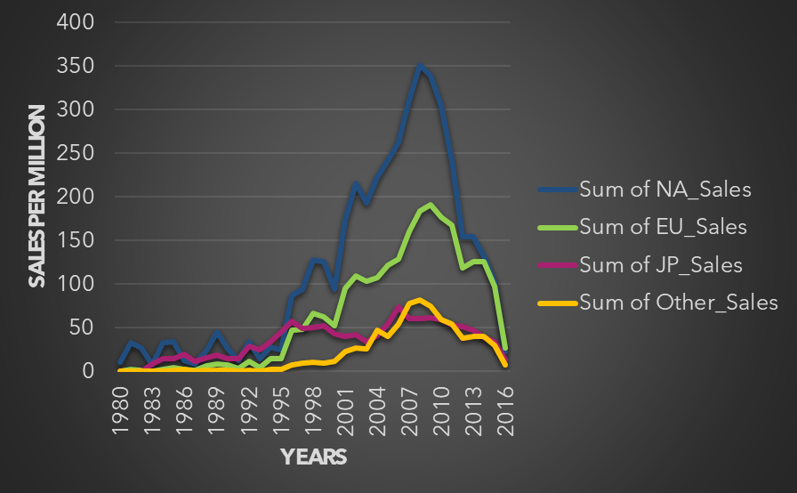
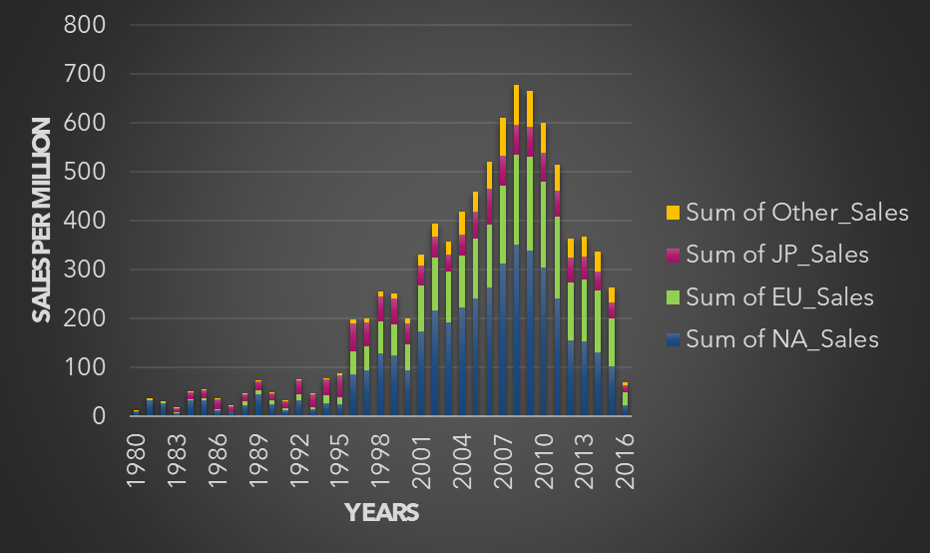
Game Co Analysis
Data displays game sales for the last 36 years between the different regions. North America is the leading market across all consecutive years.
Video game sales peaked in North America in 2008
Sales have declined overall between all 4 regions since 2010

Slide 3
Game Co Recommendations
Analysis shows video game sales for the last 36 years between the different regions showcase that sales will not be consistent for the 2017 sales year. Japan Reassessing the market space, conducting a deep analysis on why there is a decline throughout the last 18 years. Maybe its religion maybe its games not being available in that region, maybe its cost. Could also be a genre of games that are just more popular in Japan than North America and Europe.
Europe Identify what is working in Europe through market research. Start pumping more funds into marketing campaigns to penetrate the Europe market that may not have been established yet.
North America Figuring out what areas in North America are being underserved to cause sales to decline. Determine the disconnect and decide whether to pump more funds into marketing campaigns or determine to put more funds somewhere else to make up for decline.

